Slide 1


Airbnb Data Analysis Project
1
Tool Used :- PySpark
Submitted by: Harsimran Kaur-609078

Slide 2
Case Study: Airbnb
Airbnb is an online marketplace that connects people who want to rent out their homes with people looking for accommodations in that locale. NYC is the most populous city in the United States, and one of the most popular tourism and business places globally. Since 2008, guests and hosts have used Airbnb to expand on traveling possibilities and present a more unique, personalized way of experiencing the world. Nowadays, Airbnb became one of a kind service that is used by the whole world. Data analysts become a crucial factor for the company that provided millions of listings through Airbnb. These listings generate a lot of data that can be analyzed and used for security, business decisions, understanding of customers’ and providers’ behavior on the platform, implementing innovative additional services, guiding marketing initiatives, and much more.

Slide 3
WORKFLOW:-
Import the required libraries
Creating dataFrame from CSV file
Volume of Data
Data Cleaning and Preprocessing
Data Exploration & Visualization

Slide 4
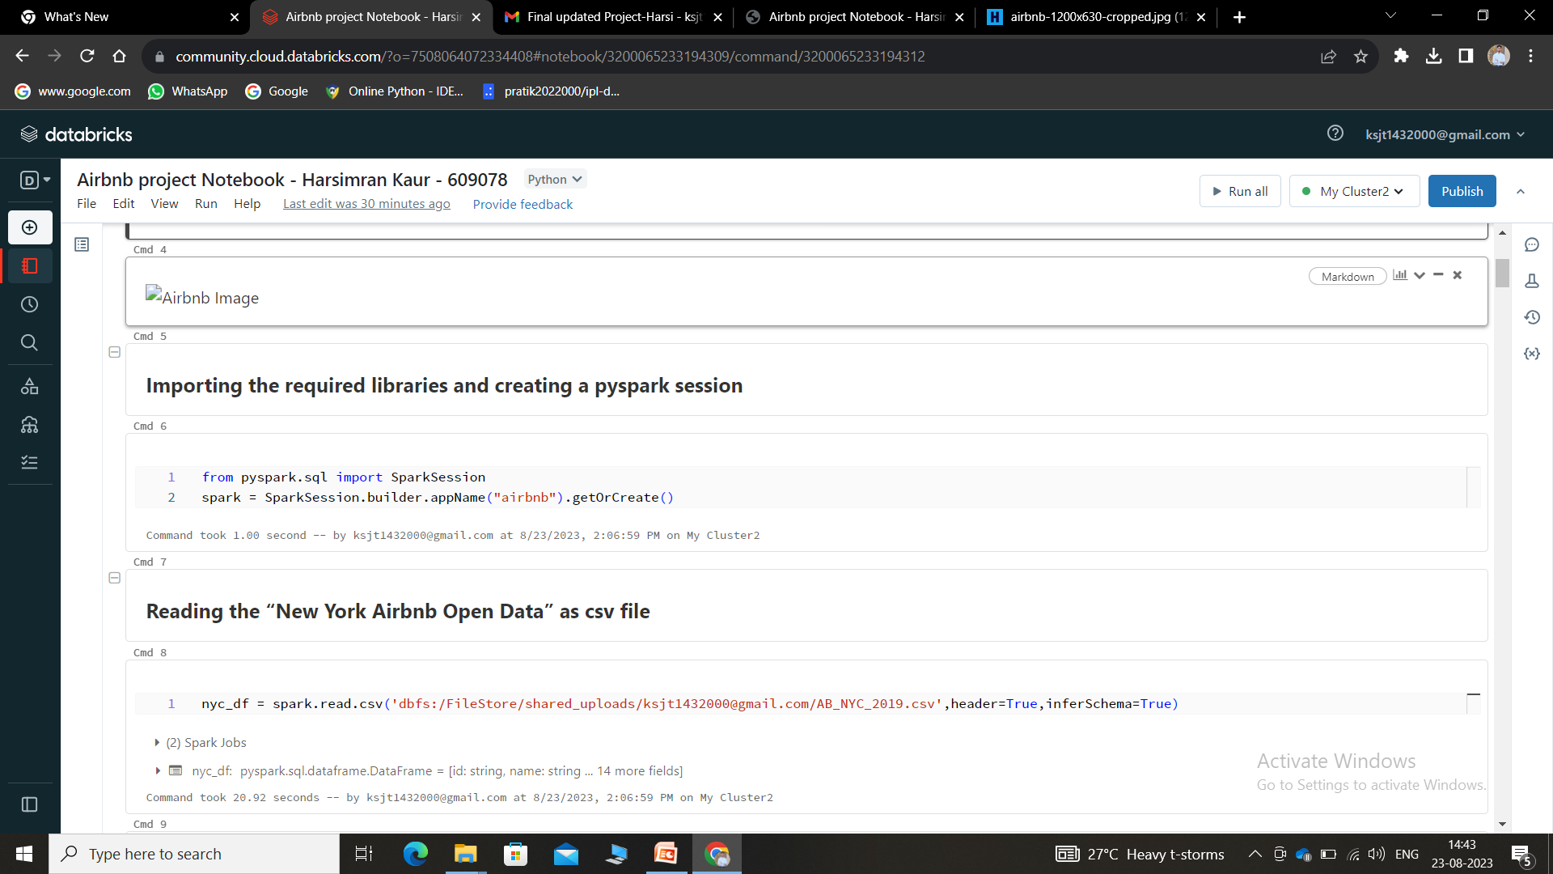
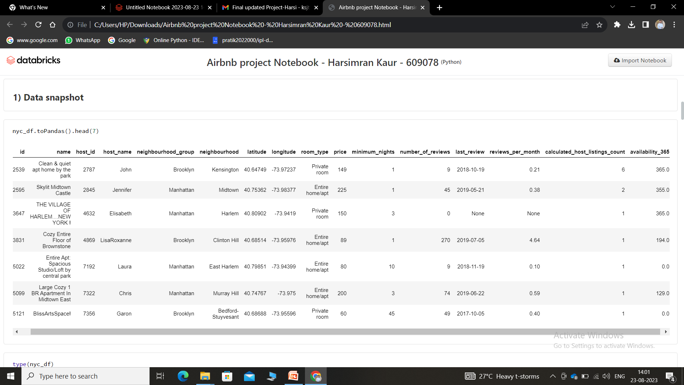
Importing the Required Libraries:-
Creating DataFrame from csv file

Slide 5
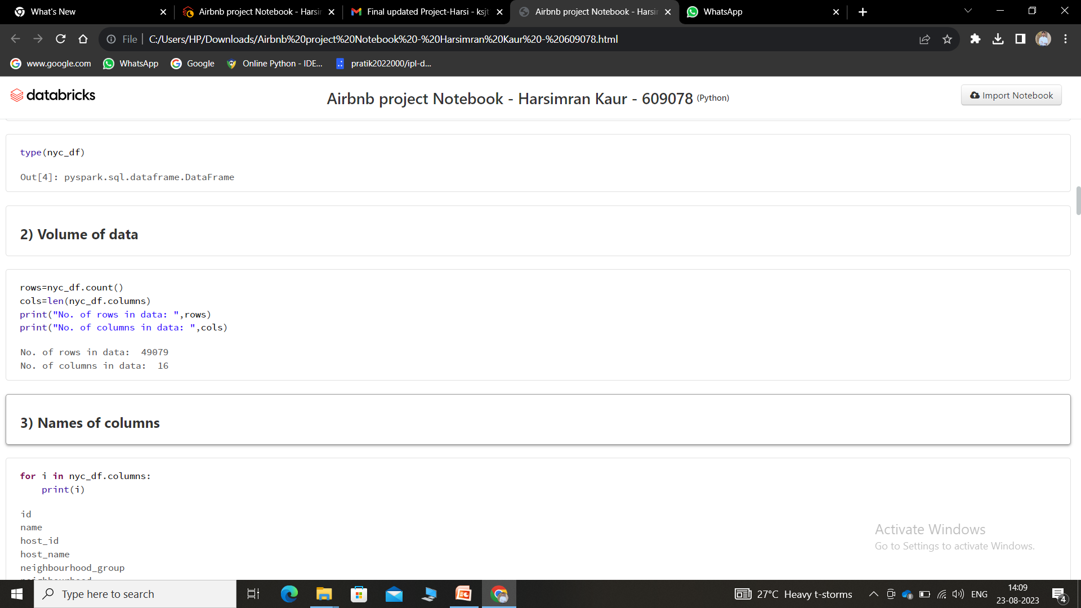

Volume of Data :-
Names of Columns:-
From above command it is found that, in this dataset, total number of rows are 49079 and total number of columns are 16.

Slide 6

Data Schema:-
Schema of the dataset will tells us about the datatype of each attribute present in the data as well as about the null value permission

Slide 7
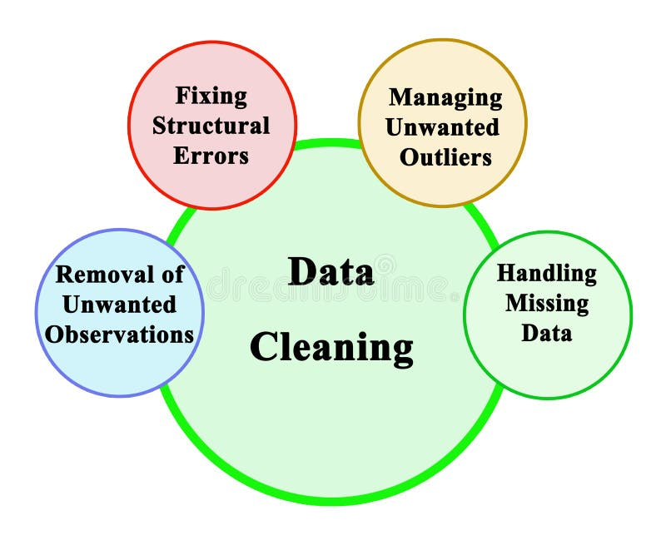
Data Cleaning :-
Data cleaning is the process of identifying and rectifying errors, inconsistencies, and inaccuracies in a dataset. It involves tasks like dealing with missing values, correcting typos, handling duplicate entries, and ensuring data conforms to a standardized format. The objective of data cleaning is to enhance the quality and reliability of the data, making it suitable for analysis.

Slide 8
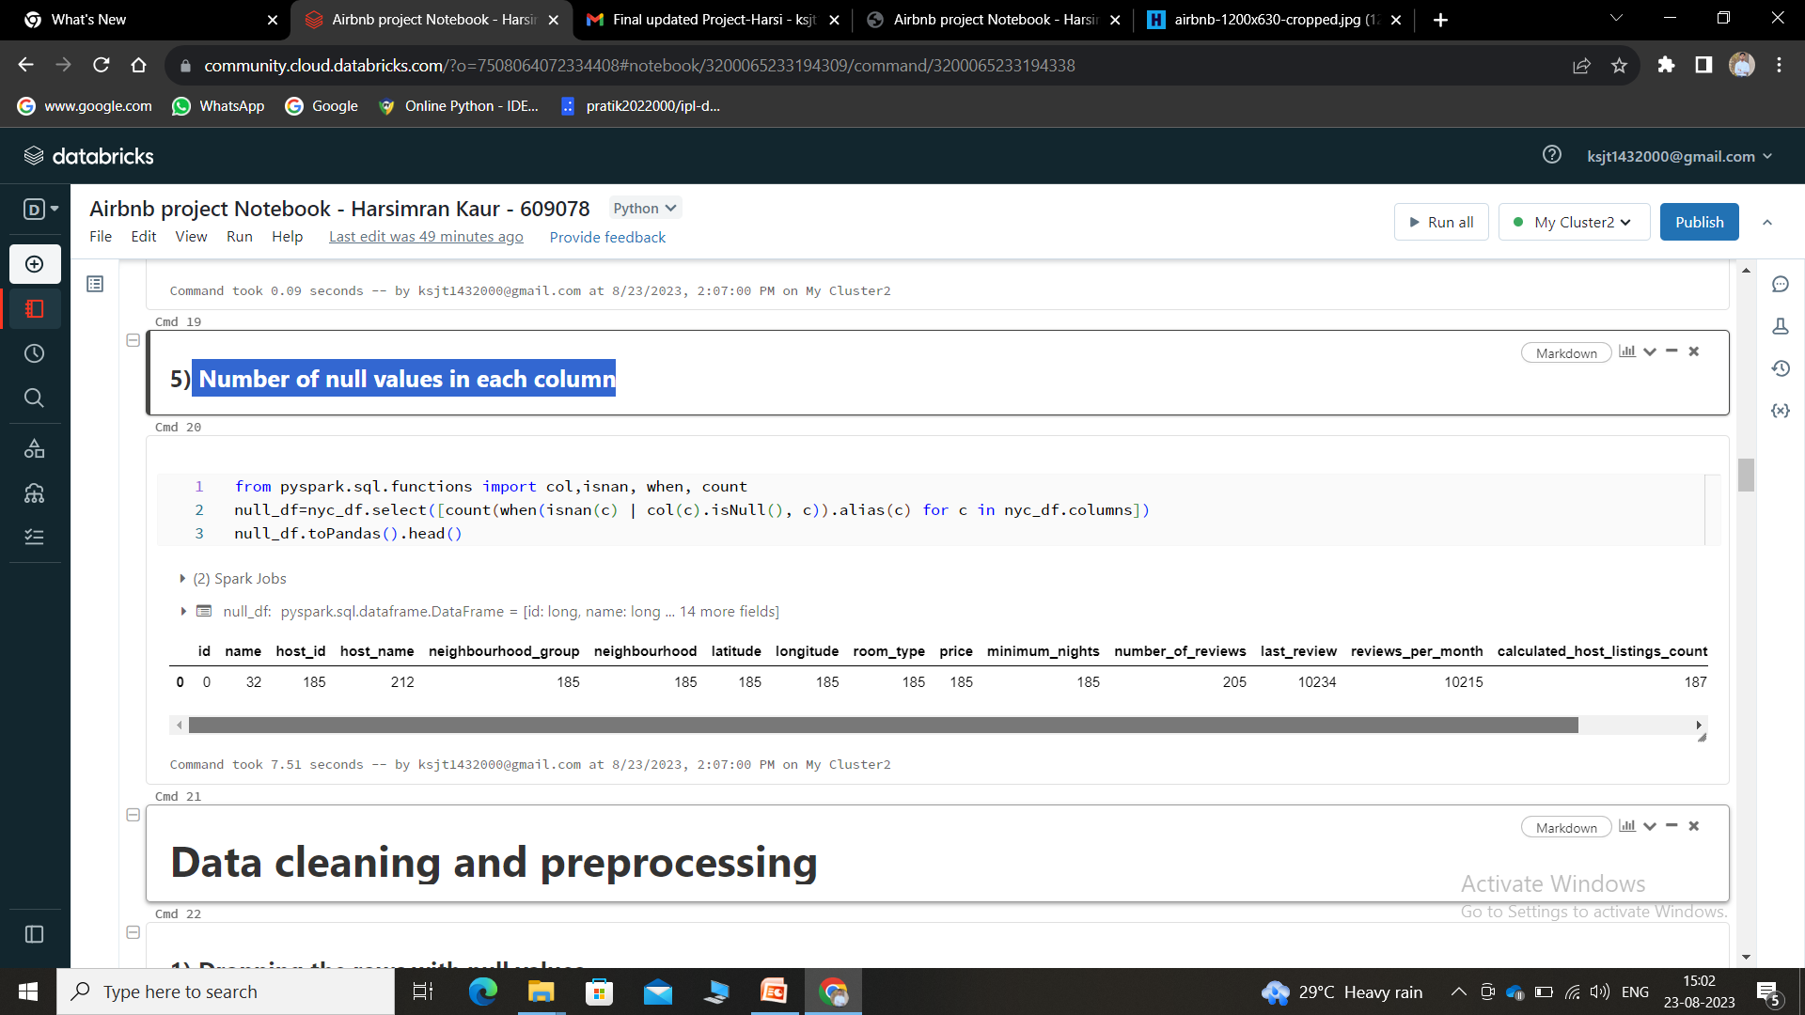
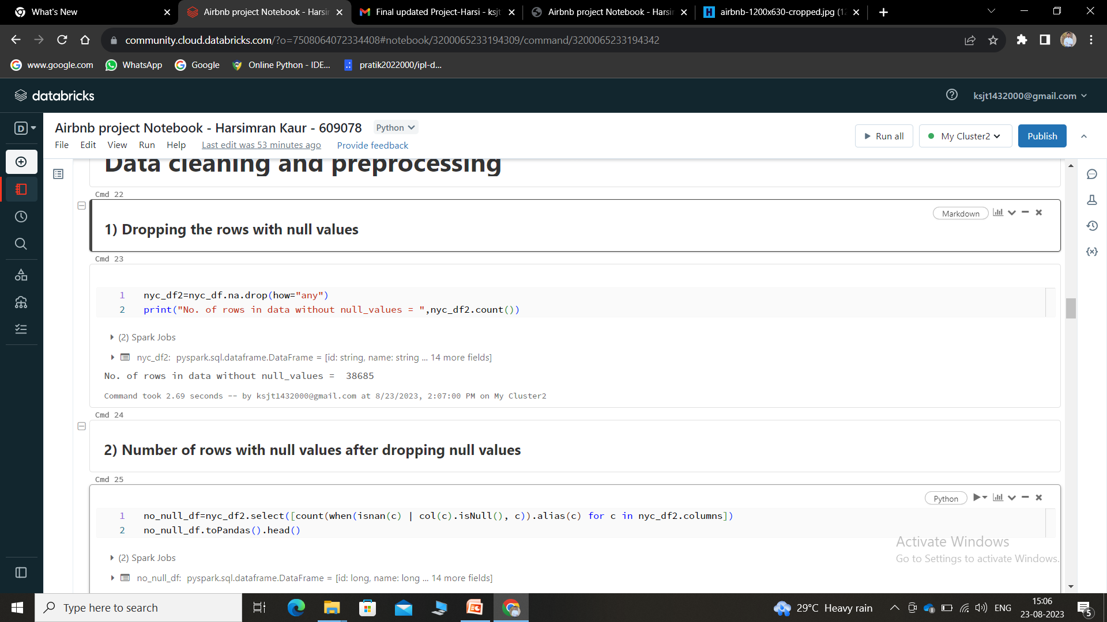
Number of null values in each column:-
Dropping the rows with null values :-
Handling Null Values

Slide 9
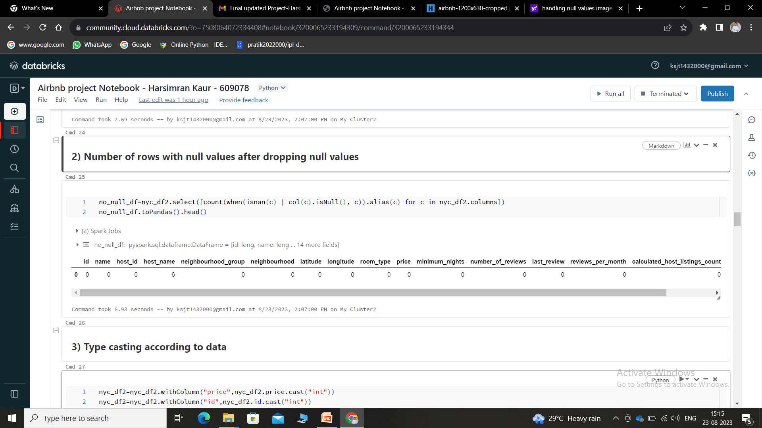
Number of rows with null values after dropping null values :-
No null values left in this dataset except hostname

Slide 10
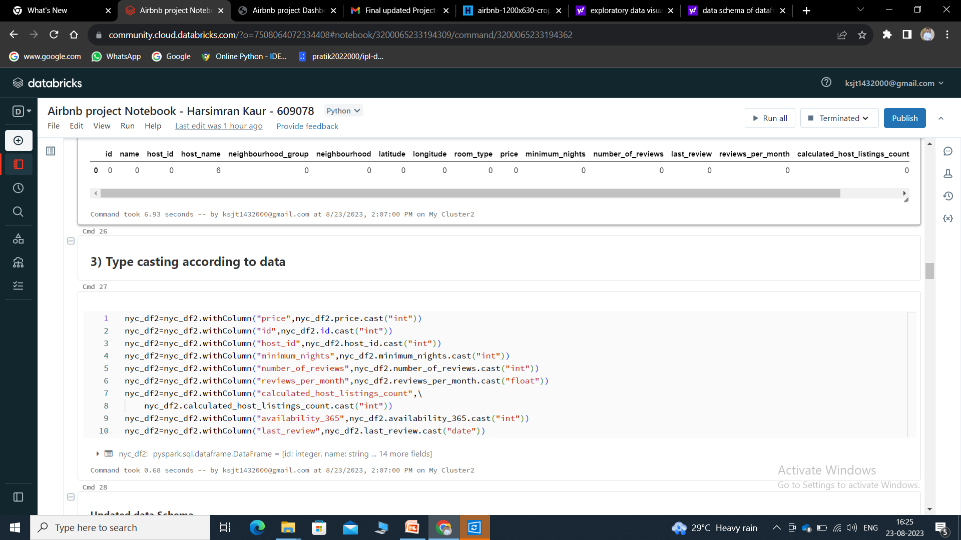

Type casting according to data :-

Slide 11

Exploratory Data Visualization :-
In a nutshell, exploratory data visualization helps you figure out what’s in your data, while explanatory visualization helps you to communicate what you’ve found. Exploration takes place while you’re still analyzing the data, while explanation comes towards the end of the process when you’re ready to share your findings.

Slide 12
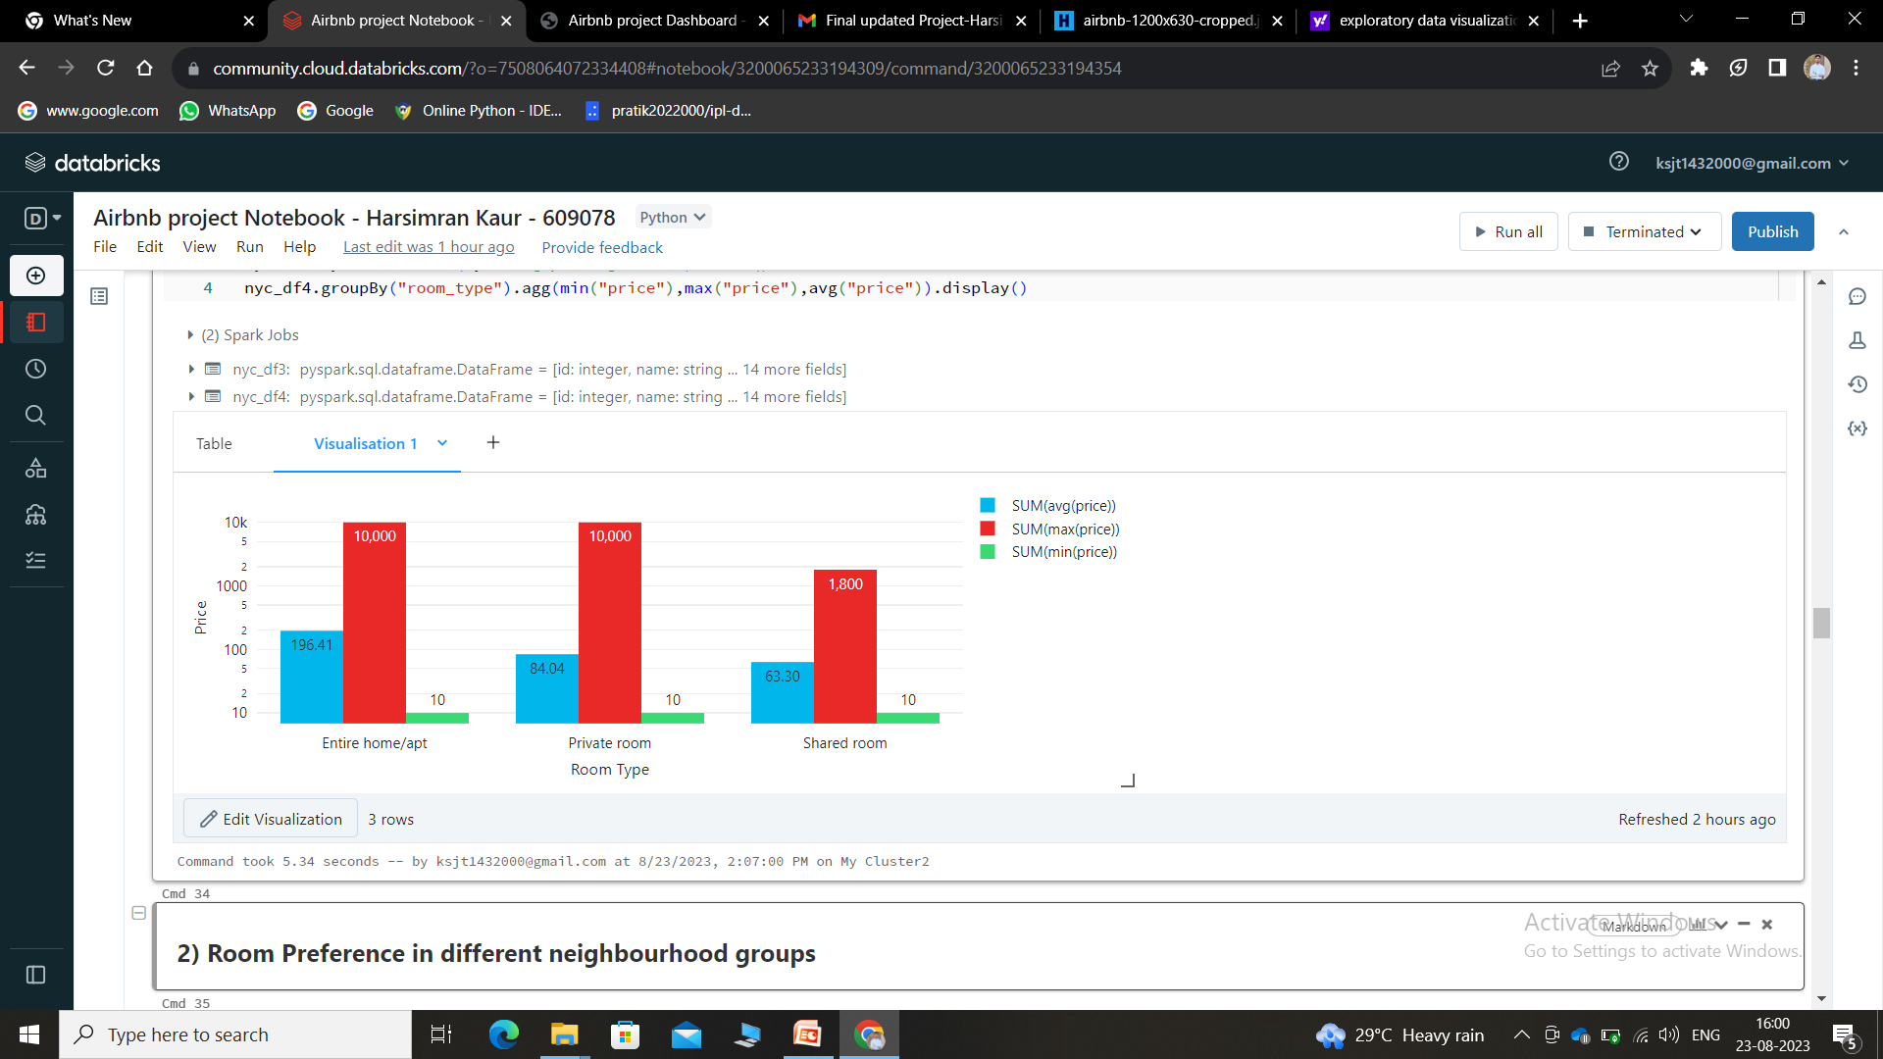
Price of different types of rooms :-
From the average price of each room type, we get to know that the Entire home/apt are the most expensive followed by the private rooms.

Slide 13
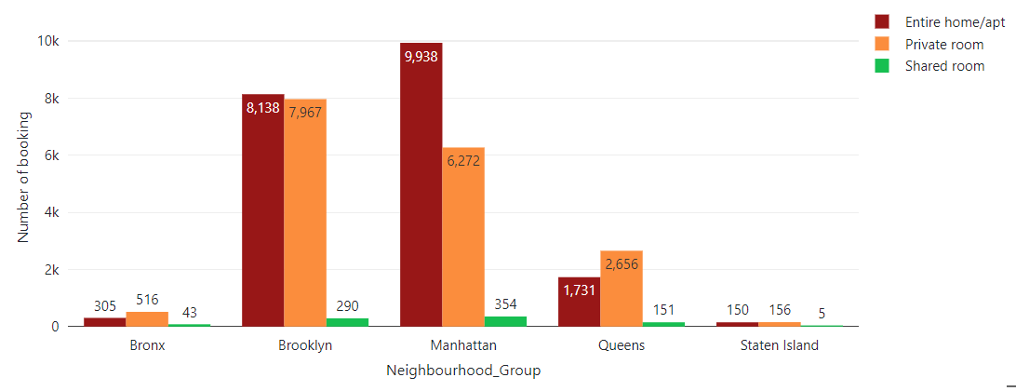
Room Preference in different neighbourhood groups :-
Manhattan group have most number of bookings followed by the Brooklyn.

Slide 14
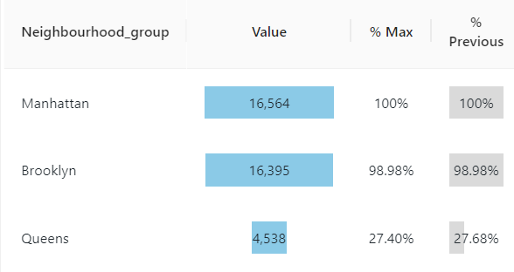
Total booking in each neighbourhood group :-

Slide 15
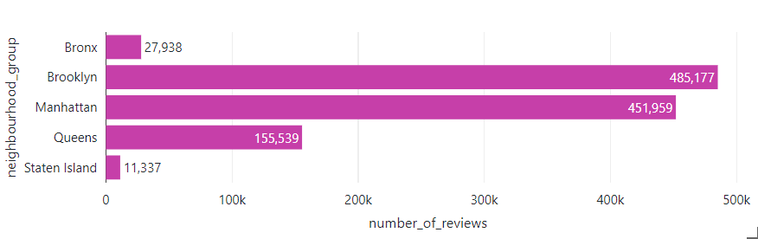
Number of reviews in each neighbourhood group :-

Slide 16
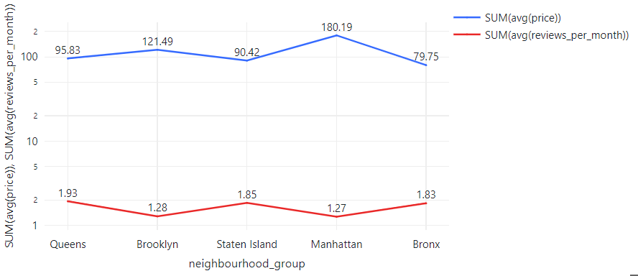
Reviews VS Price in different neighbourhood groups :-
From plot, we can see that "Manhattan" group have least number of reviews despite of having expensive rooms.

Slide 17
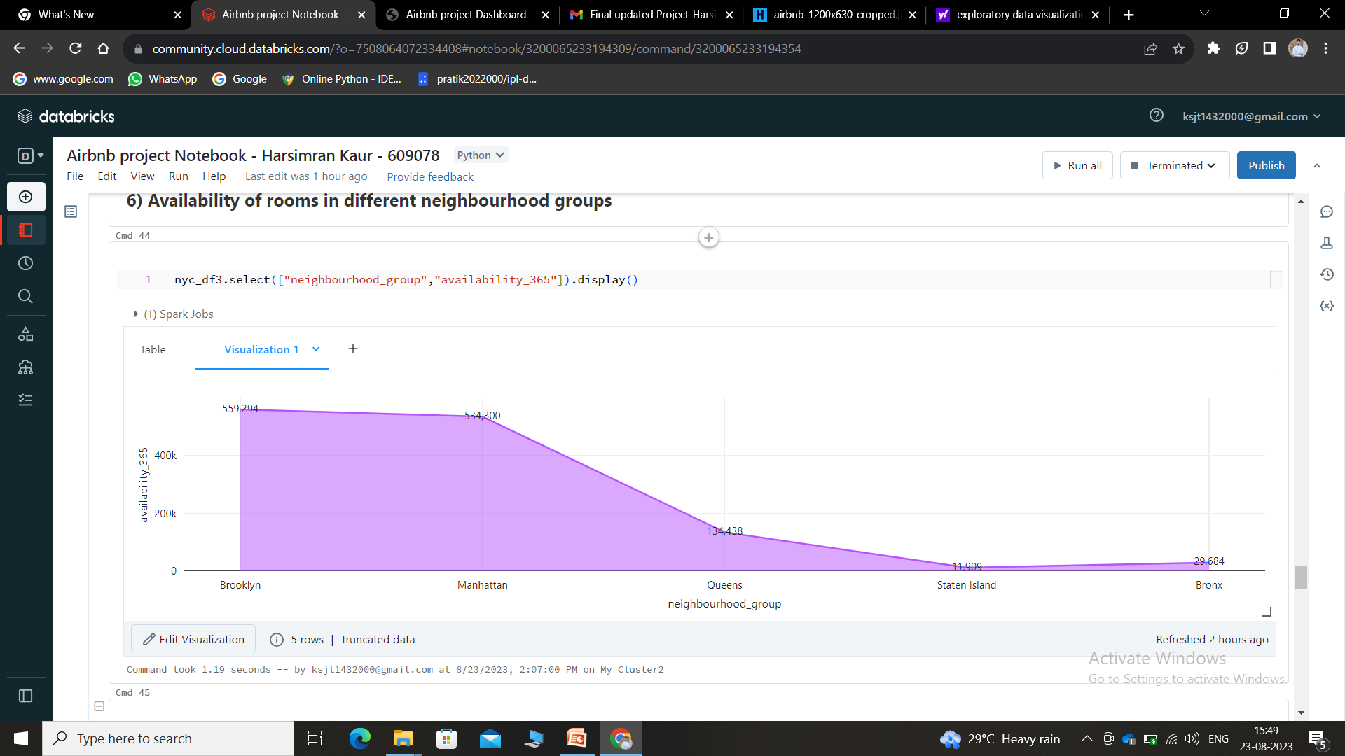
Availability of rooms in different neighbourhood groups :-

Slide 18
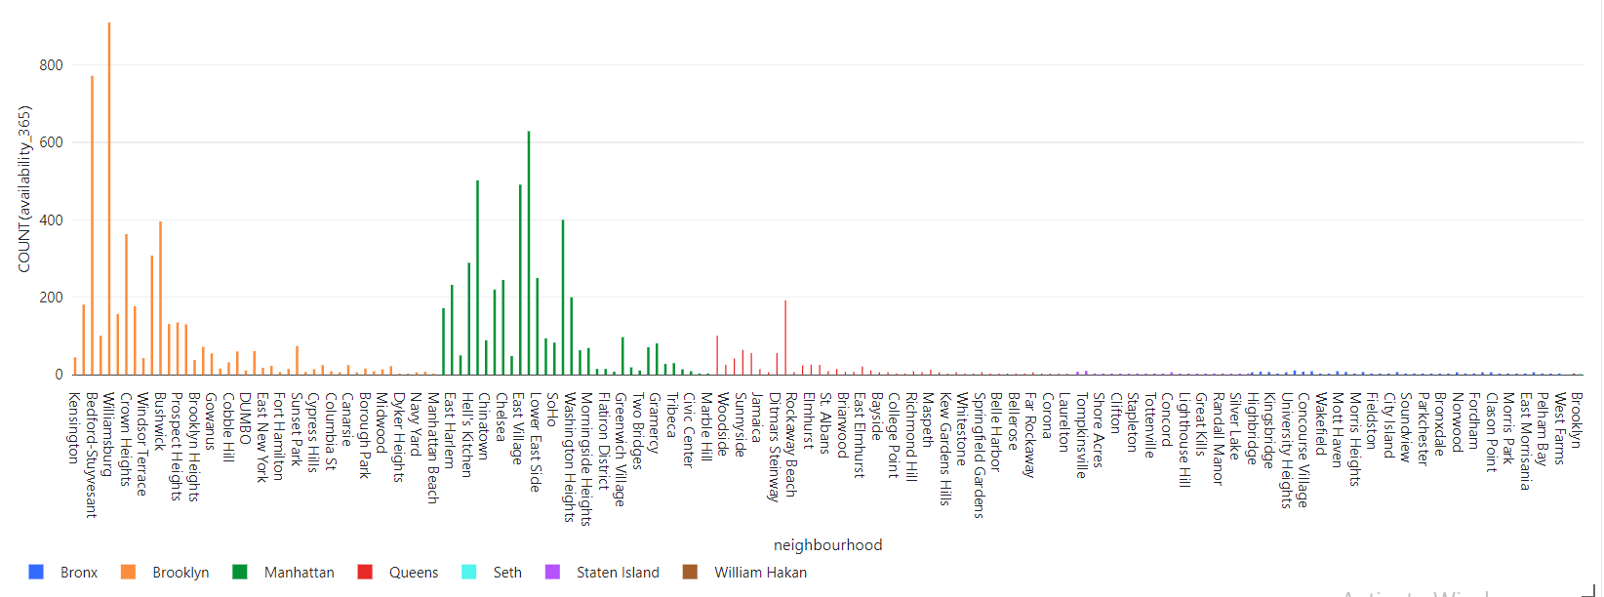
Availability in different places :-

Slide 19
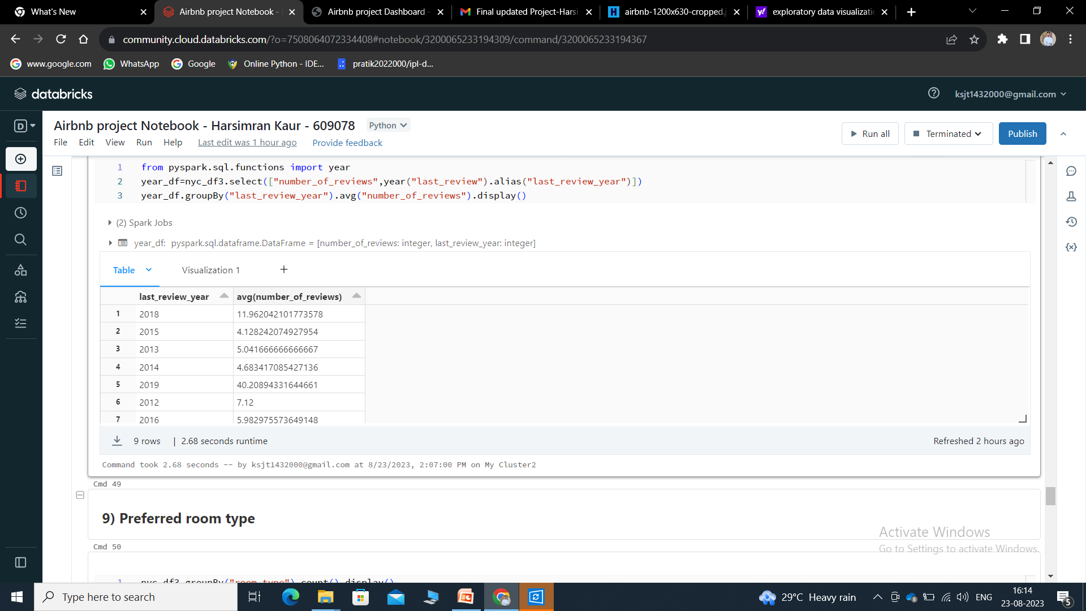
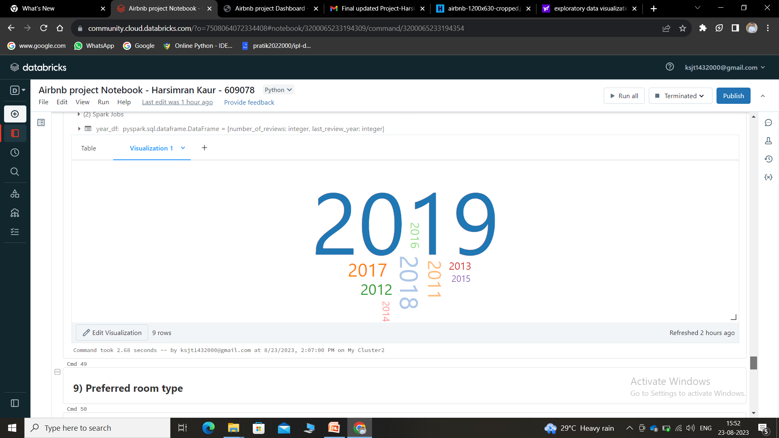
Average reviews per year :-

Slide 20
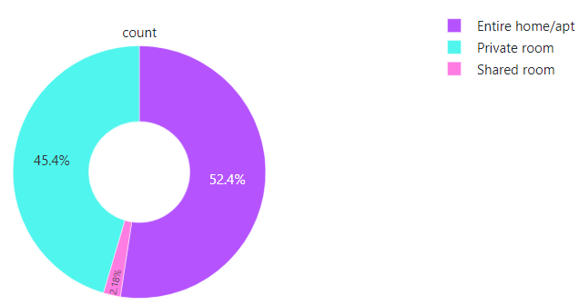
Preferred room type :-
Shared room type is less preferred as compared to others

Slide 21
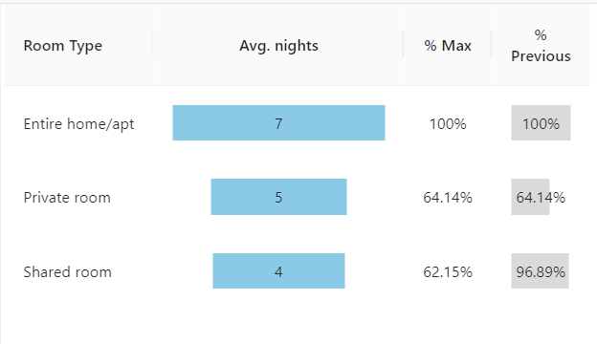
Minimum Nights spent in each room type :-

Slide 22
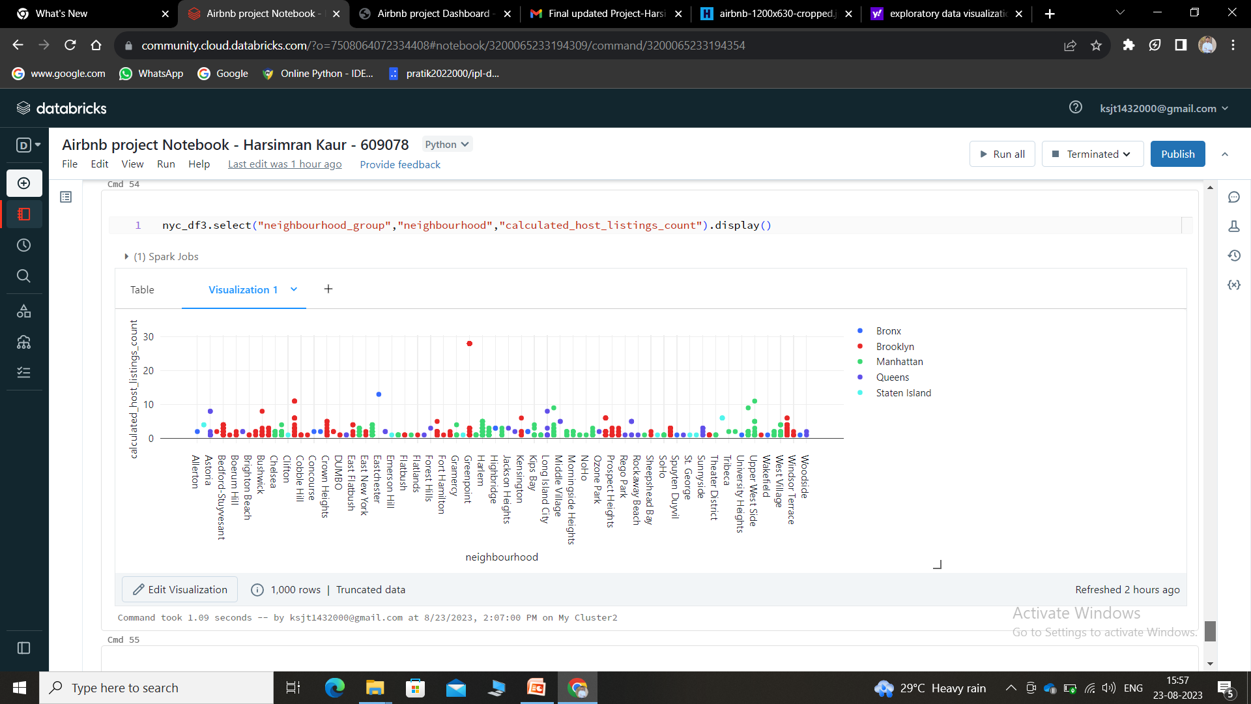
Comparing host_listings_count of different sites of Airbnb

Slide 23
THANKS!
Harsimran Kaur

